Slide 1
Conditions for Partnership: Contribution from Catholic Social Teaching
Paul Tighe
Religions and the Sustainable Development Goals
Rome, 8th March 2019

Slide 2
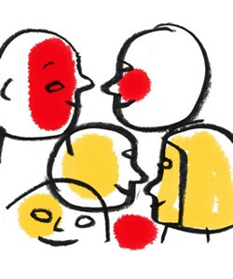
Council for Culture

Slide 3
Introduction
Pontifical Council for Culture (Dialogue with non-believers), encounter
Cardinal Ravasi – philologist (dia logoi)
Encounter and deepen (deep conversations)
Condition for partnership
Contribution from Catholic Social Teaching – dialogical by nature and methodology
Specific insights – driver of engagement

Slide 4

Church and World

Slide 5
Church and World
Church cares for world – offers (God’s love for all, human worth, solidarity and communion) and receives (bi-directional learning)
Pilgrim Church – journeys with, shares concerns, goes beyond itself
Unity of human family – sons and daughters
Common Home – build together, inequality (material, democratic, destiny - meritocracy)

Slide 6

Dialogical

Slide 7
CST - Dialogical
Evolving – work in progress, not static
Complexity (inter-linked) – inter-disciplinary
Cultures and traditions – wisdom/values
Inclusivity – need for range of voices (logoi)
Action (chapter 5, Laudato Si) - dialogues

Slide 8

Human flourishing

Slide 9
Human flourishing
Searching for truth together – rooted in human nature (image and likeness)
Objectivity – what enriches? what destroys?
Natural moral law – method, open but needs to be inclusive and adequate
Limitations – essentialist, western, male (8th March, silence not consensus), generational
Human rights discourse – dignity, worth (intrinsic, innate, inalienable)

Slide 10

Human Potential

Slide 11
Understanding Human Potential
Faith and Reason
Science – celebration
Technocratic paradigm (reductionist – epistemology, dualism, commercial)
Cultural ecology
Arts – aesthetic education and empathy (visual and narrative arts)
Service – learning habits, finding self

Slide 12

Digital World

Slide 13
Dialogue in a digital world
Beyond optimism – human achievement, network of people
Polarization – media, public, be present
Education – listening, reflection, discernment, intentionality and attentiveness (slow)
Humanities – Hochschild (deep truths), Turkle (reclaiming conversation), Sunstein (democracy divided)
Visual – new forms of literacy

Slide 14
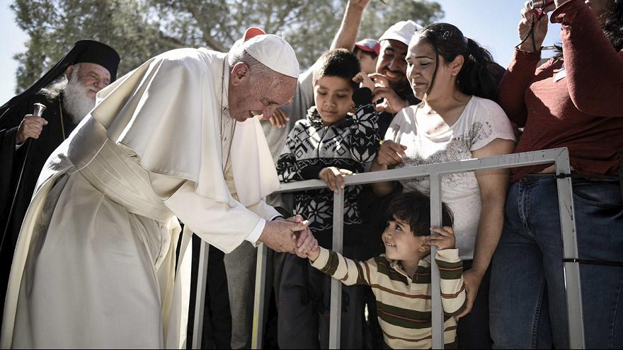
Dialogue as a commitment

Slide 15
Dialogue as a commitment
Other – proximity (love and hope) or distance (fear and hate)
Diversity – richness, learn, incremental
Faith communities – empowering leadership, constituency for positivity
Conversion – motivation, stories, anti-myths
Contemplation – joyful mystery, gratitude
Welby and Sacks

